Slide 1

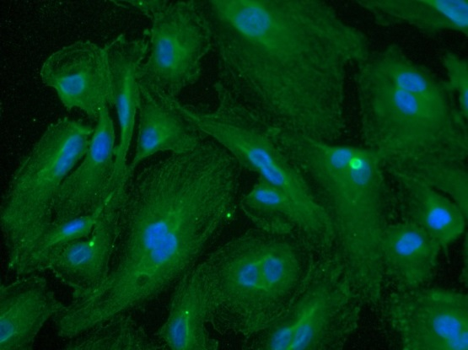
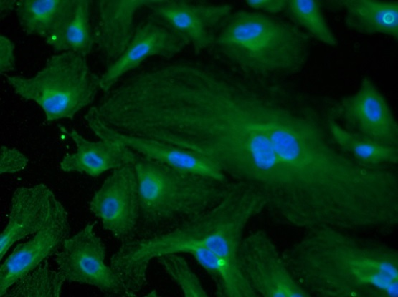
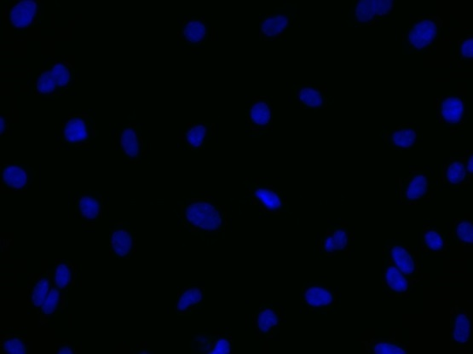
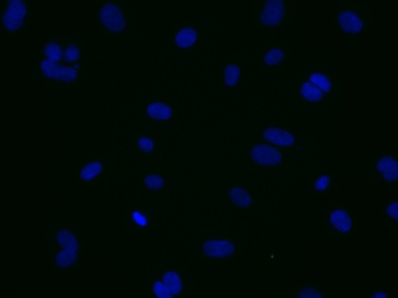
ReliaTech GmbH
Mouse anti-human PlGF (#3B10)
mouse anti-human PlGF
mouse anti-human PlGF
Control (goat anti-mouse IgG ALEXA Flour 488; 1:600)
Immunofluorescence staining of human PlGF in HUVE cells with the monoclonal mouse anti-human PlGF #3B10 [Cat# 101-M65] antibody (upper panel). Control with goat anti-mouse ALEXA Flour 488 [Dianova] (lower panel).
[IF_HU1407-01; 101-M65 (7,5µg/ml) 400X;]
http://www.reliatech.de / orders@reliatech.de

